Slide 1
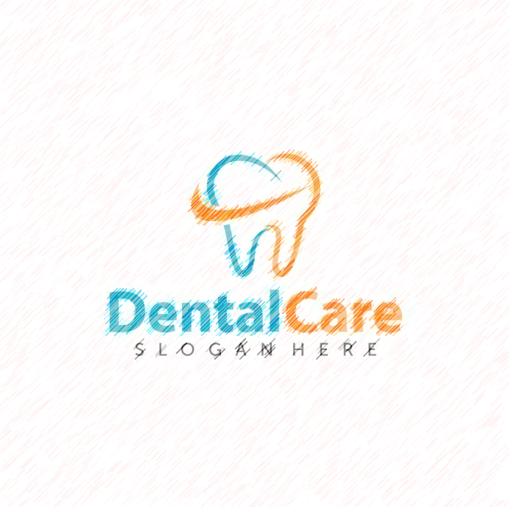
DENTAL CARE DASHBOARD
A comprehensive dental care data on dental products and their various means of advertisement, medium, location, spend and gross spend

Slide 2
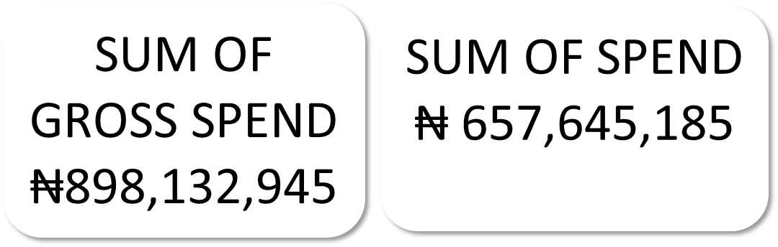
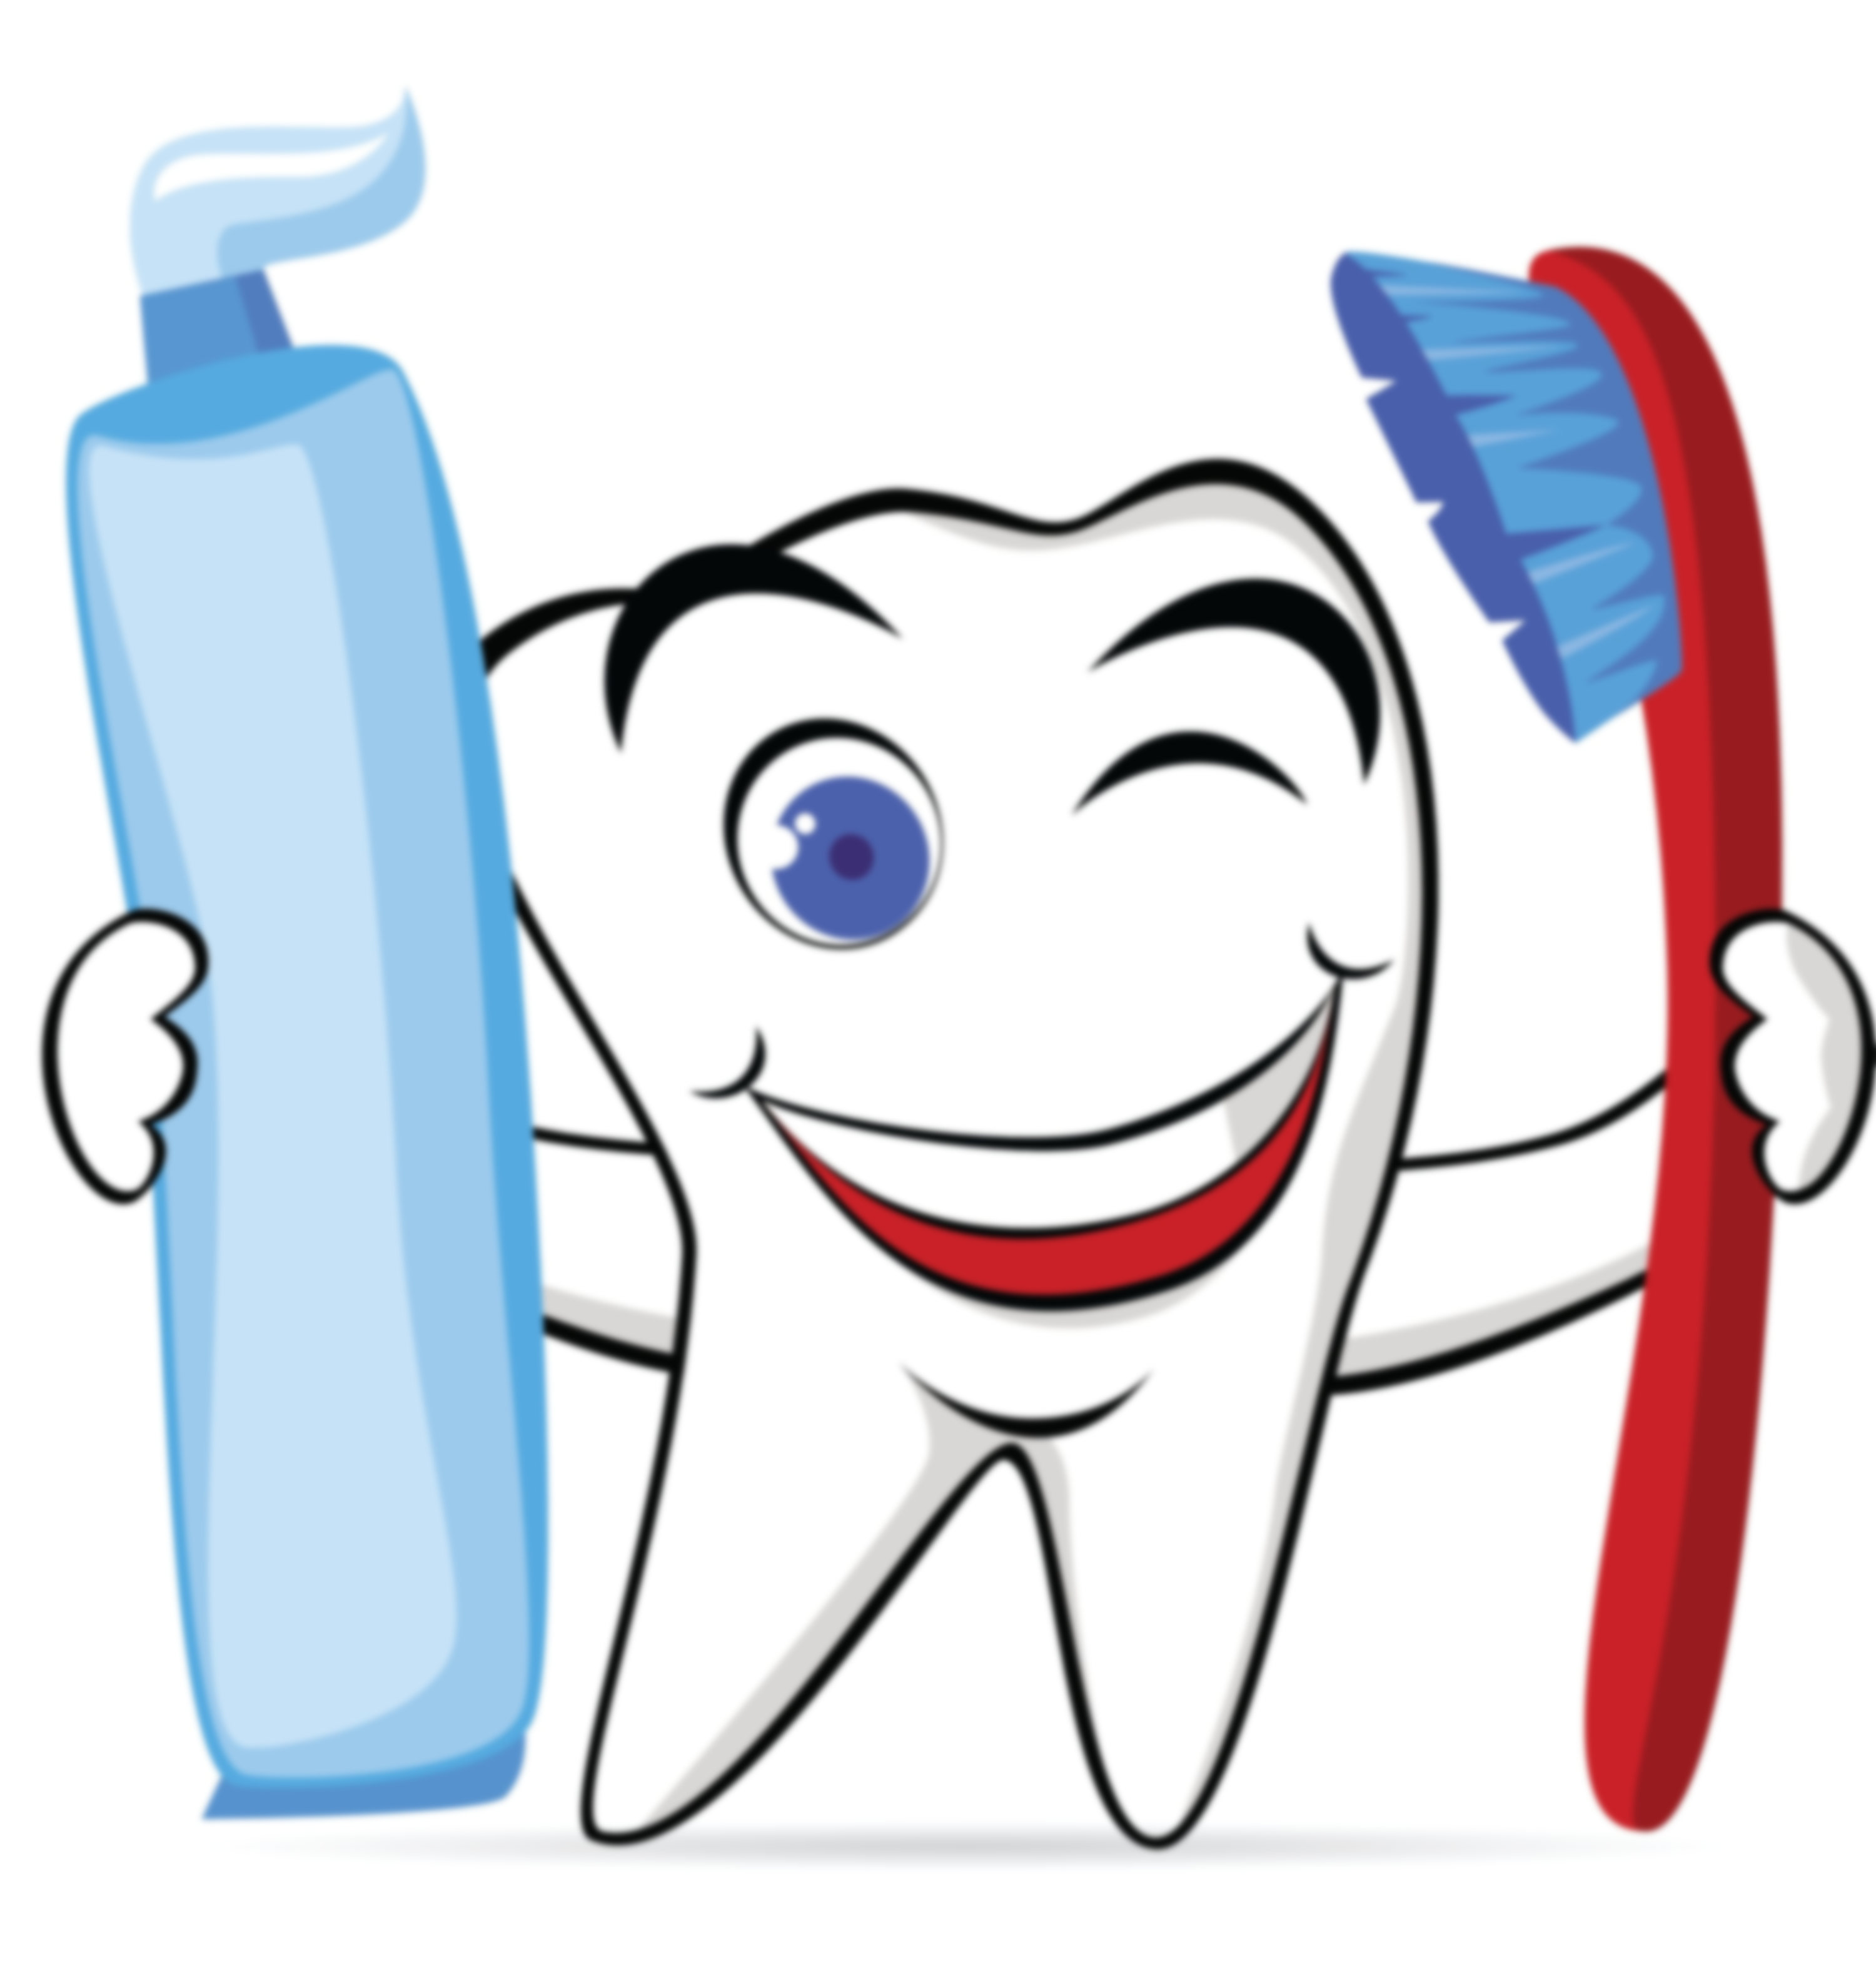
Six hundred and fifty seven million, six hundred and forty five thousand one hundred and eighty five.
Eight hundred and ninety eight million, one hundred and thirty two thousand nine hundred and forty five Naira

Slide 3
NB: This is the total count of each stations by the Brands

Slide 10
NB: Count of Programs shown by each ADDATE.

Slide 16
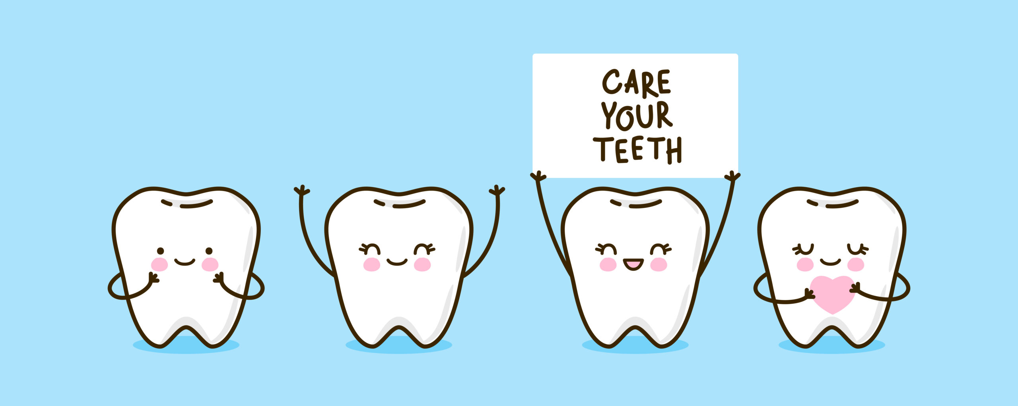
SUMMARY
After various analysis and interpretation of the data we realised that the best advertising brand was ‘Colgate (Colgate cavity protection [locks calcium in]) ’ with the total gross pend of #476,844,541 having LED DISPLAY BOARD as the highest earning program and OUTDOOR as the highest means of Advert.
Close up with the gross spend of #168,337,976 and total spend of #107,801,695 with Lagos being the top spending location, Outdoor being the highest ‘Station’ with the sum spend of #16,951,923 and Run off spots- TV (CABLE TV) with the highest spending program having multiple station with high spend in the likes of African Magic family(DSTV) with #15,000,000. African Magic Showcase DSTV with #15,180,000 and Nigerian Idol DSTV with #14,940,000
Oral-B with the total spend of #69,176,950 with TV 60% and Cable Tv 40% medium of advert
Lagos with the best advertising location with Outdoor followed by cable Tv

Slide 17
Tolaram Group with the highest Medium of Advert with Radio scoring 6,782 and Tv 1956
Sensodyne spent #1,482,000 on Advert with Edo being the highest advert location followed by Oyo #1,250,000 and #232,000 respectively, Outdoor with the highest medium and tv 84% and 16% Respectively
Ra Thermoseal spent #2,340,000 on advert with Lagos being the highest spending location and only means of advert was with Cable Tv (Run Off Spot-Tv)

Slide 18
CONCLUSION
Colgate spent the highest money on Advert with Tolaram Group being their Advertiser with Outdoor means of advertising

